Slide 1
American Red Cross:
Event Management System Solution
Date: January 28th, 2015

Slide 2
Introduction
American Red Cross
Ruqsana Jabbar, IBM – Smarter Cities Architect
John Senegal, IBM – Smarter Cities Public Safety Architect
Aron Bierbaum, IBM - TACCS Technical Lead
Dave Cheema, UST Global – Principal Solutions Architect
Jeff Edgington, IBM – Solution Architect
Abhay Bhandarkar, UST Global – Director Smarter Cities

Slide 3
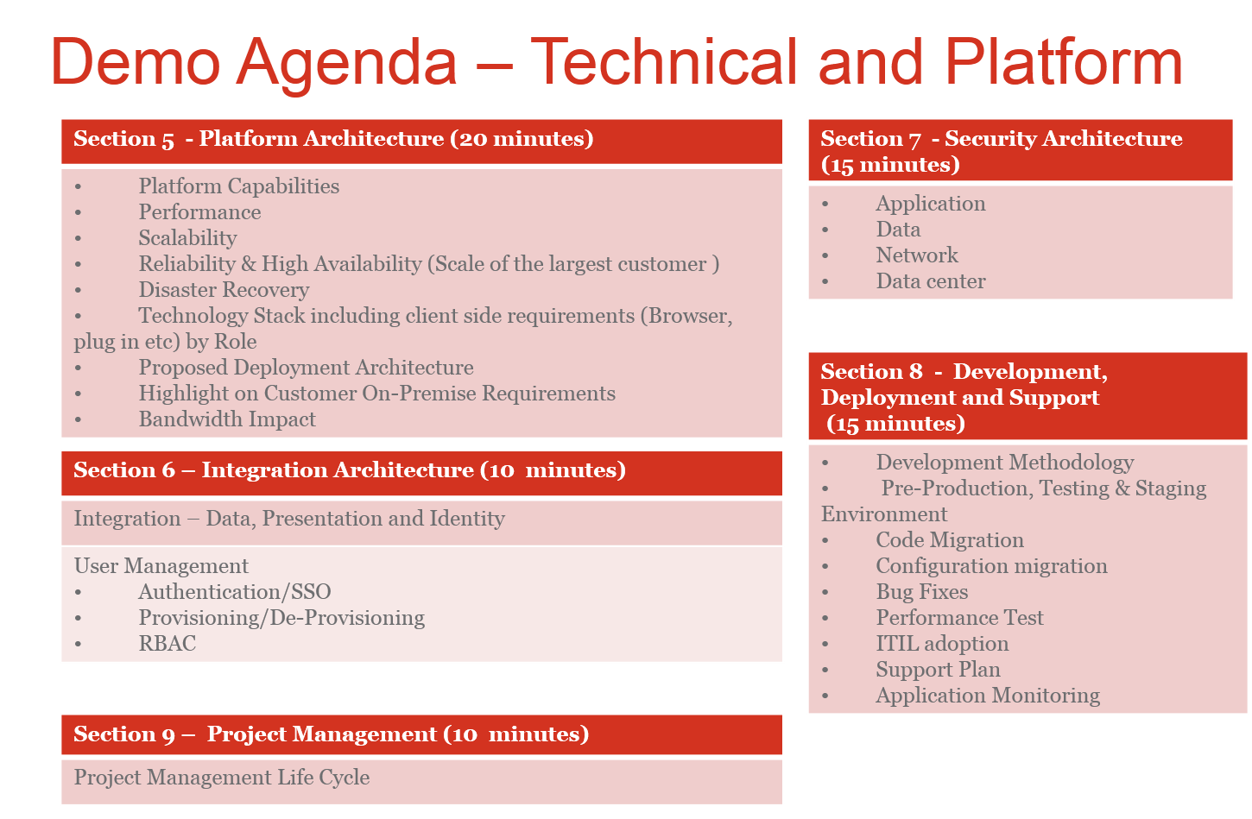
American Red Cross
Covered in meeting with ARC on Jan 21st
3

Slide 4


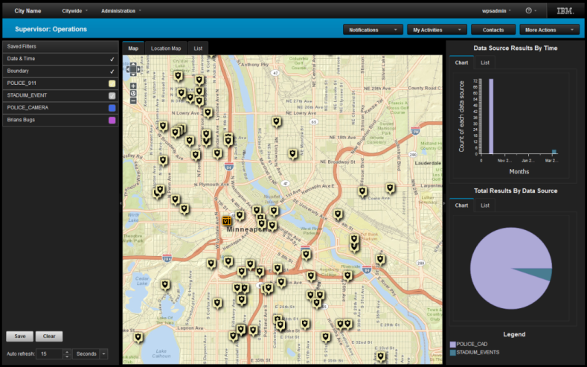





IBM Emergency Management Center provides new ways to understand your environment
Solution Overview
Integrate multiple data sources to provide a single, consolidated operational picture across the entire city or region
Deployment Ready
Video analytics
Social media analytics
Sensors
Correlation
Citizen collaboration
Prediction
City events
4

Slide 5
Intelligent Operations Center for H3
System Context
Fixed/Mobile Feeding Teams
Client Portal
(self service)
Public Information Sources(USGS,E911,USPS,Parcel Info, etc.)
Weather Information
(NWS, NOAA)
Intelligent
Operations Center
(Portal, Dashboard)
Registration, services available, received
Alerts, notifications, real time updates, meal distribution info, GPS Tracking
Query, Response(lists of addresses)
Weather information feeds
Geographical Information
System (GIS)
ARC User
Alerts/Events, Query, Response, Reports, ICS input
Geospatial
data
Smartphone
Alerts,
DA info, pictures
Approved partner agencies/FEMA
IOC for
Humanitarian Services
Support System (H3)
Incident Mgmt Info
Mobile User (Volunteer, etc.)
Client’s digital signatures, client info
Safe and Well Linking System
DR events,
DA information
import
CAS
(Client Assistance System)
export
All Events, Requisition Information
Query,
shelter info
All Events, DAT Schedules, volunteer info
Shelter Repository
DR events
Incident Mgmt Info
Inventory Mgmt
(Oracle)
Logistics
System
ARIBA
IKD System
Other External Sources
National Shelter
System (NSS)
Volunteer Connection
National VOAD

Slide 6
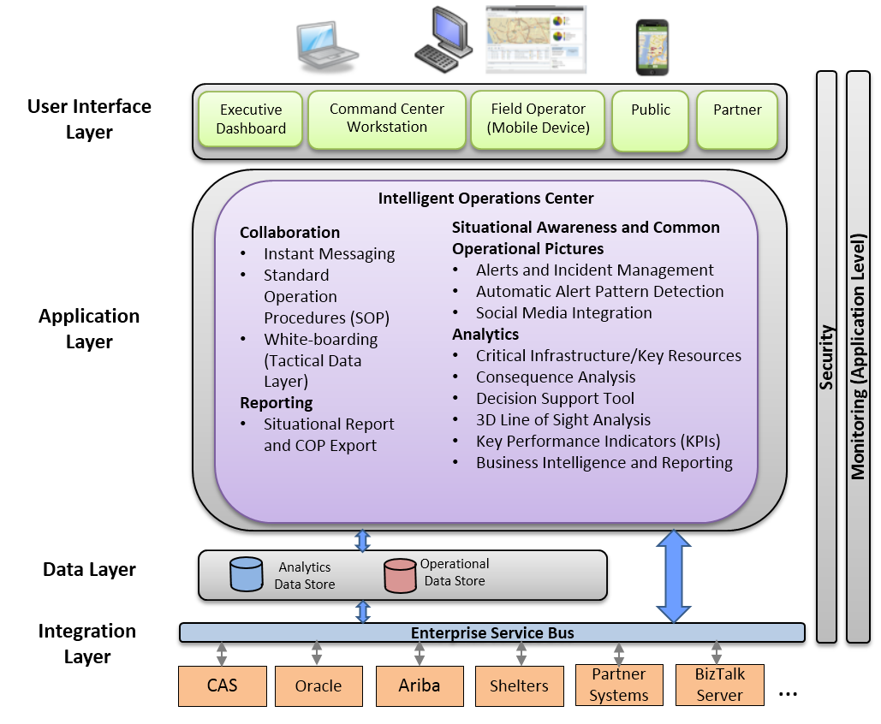
Conceptual Architecture
Platform Architecture

Slide 7
Platform Capabilities
Platform Capabilities
Standards Based Platform with Industry Leading Technologies
Based on open, standards based and Service Oriented Architecture
Executive Dashboard with holistic view of Operations and Mission Readiness
Role Based Access Control (RBAC)
Common Operational Picture(COP) shared across the Command Center, Field Operators, First Responders using mobile devices and other delivery channels
Situational Awareness/Decision Support
Advanced Operational Platform for mission critical emergency management
Real time geospatial framework that provides unparalleled command and control functionality
Rapid Coordinated Response through SOPs
Alert and Incident Management
Automated Alert Analysis and Alert Correlation

Slide 8
Platform Capabilities
Platform Capabilities
Asset Creation capability to enhance monitoring of critical infrastructure
Enhance user experience through rich visualizations including touch screen displays and 3-D representations
Display supports multiple layers of geospatial information that can be simultaneously superimposed
Integration of disparate sources of information into the COP environment in real time
Comprehensive reporting platform including ad-hoc reports
Ability to run “what if” scenarios in the COP to evaluate the potential impacts of man-made or natural events
Advanced Data Analytics, Optimizations, Modeling and Simulation
Event Recovery Planning
Mobile Networking Support
Network Whiteboarding allows multiple users to interactively collaborate

Slide 9
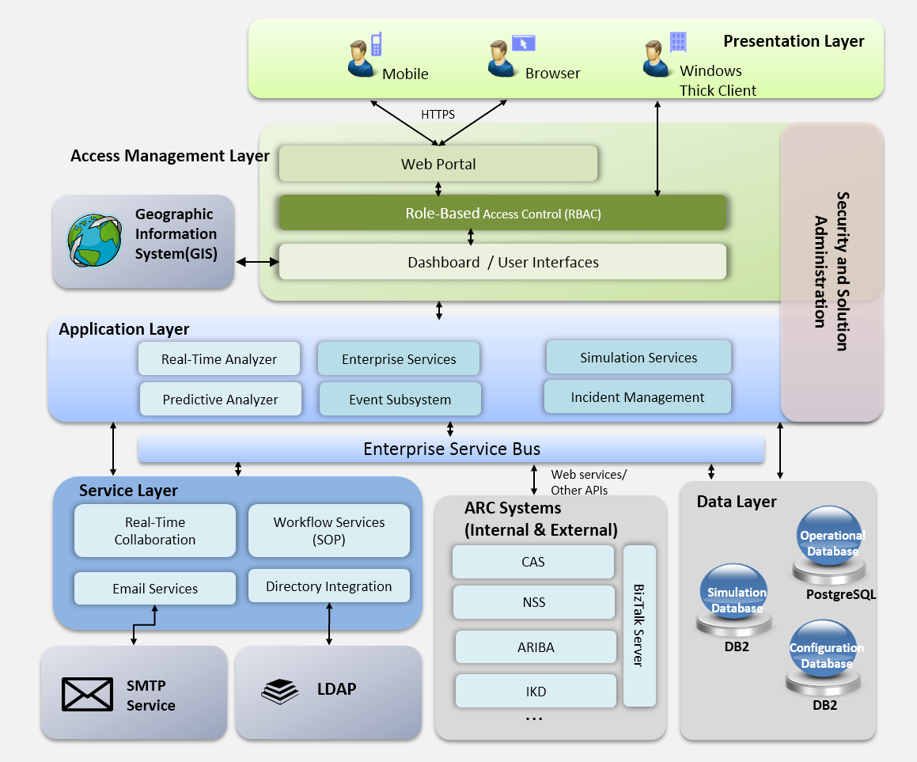
Logical Architecture
Platform Architecture

Slide 10
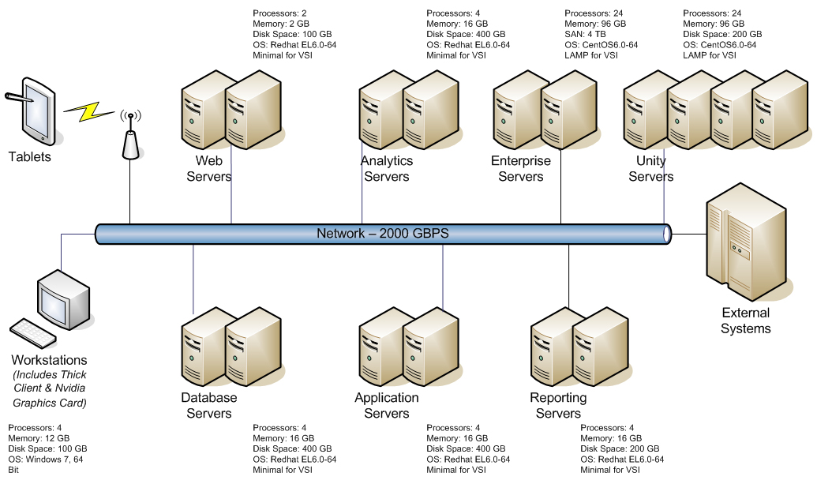
Infrastructure Architecture
Platform Architecture

Slide 11
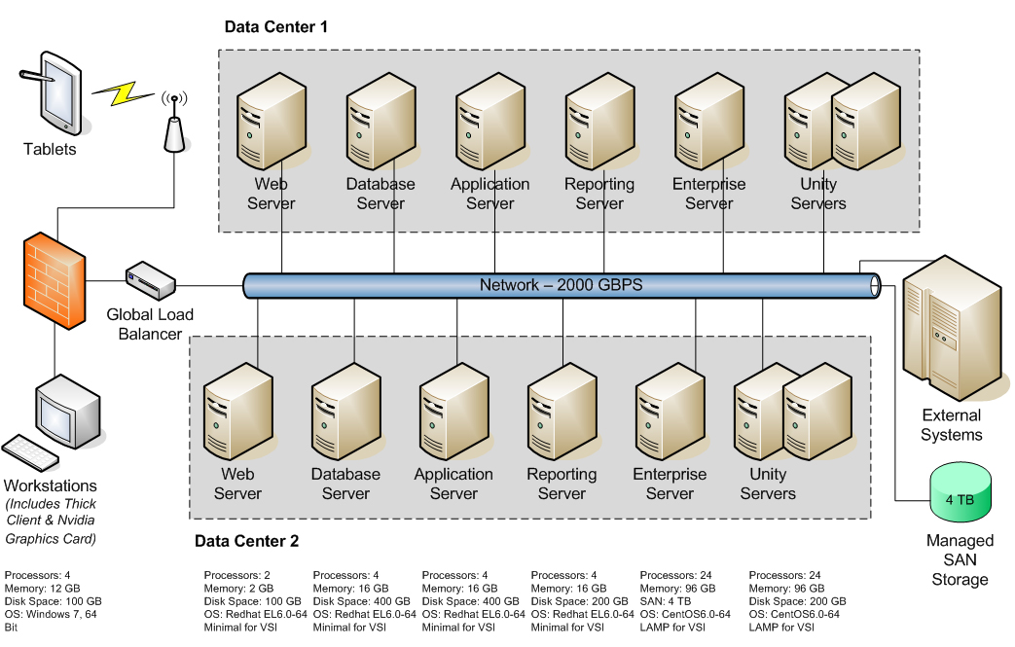
Deployment Architecture
Platform Architecture

Slide 12
Performance
Platform Architecture
Performance focused architecture to ensure specified performance SLAs are met or exceeded
Perpetual performance monitoring - the cloud infrastructure will monitor the system performance. At the earliest degradation sign, it will automatically add additional hardware, based on configuration settings, to meet the performance objectives
Average response time for critical business functions will be 2 seconds
95% of critical business functions involving dynamic content will be completed within 5 seconds
All responses will be completed within 10 seconds or less
Standard/canned reports will be completed within 15 seconds or less
During peak usage time, the performance will not degrade from its normal performance
Episodic operations performance will not decrease below 1.5 of the normal performance

Slide 13
Scalability
Platform Architecture
Our solution architecture is designed to adequately support the user load requirements of this RFP
The cloud based solution will provide the needed scalability to handle the variable loads on the system, e.g., episodic operations
The system configuration settings will provide the right-size scalability
Additional server capacity can be added during disaster events based on demands
Future growth of additional user load on the system will be handled by adding additional compute nodes. No software changes will be required
Initially the system will be able to handle 5000 concurrent users and 500 concurrent events, with 2% annual growth

Slide 14
Reliability & High Availability
Platform Architecture
H3 solution is designed to be a high reliability and high availability system
Auto Virtual Server Instance Creation - if one server instance goes down, another instance, based on defined configuration settings, is instantly created and rolled in
No component is deployed as single instance. Every compute instance to deployed to be fail-safe
Redundant, best-in-class infrastructure - all data centers maintain multiple power feeds, fiber links, dedicated generators, and battery backups
Infrastructure is built from industry-leading hardware and equipment to ensure the highest level of performance, reliability, and interoperability
Geographic diversity - the solution is deployed on fully-featured data centers with wide geographic diversity, ideal for maintaining system and data redundancy, as well as optimal for traffic volumes and speeds
On-demand, virtual data center - through IPMI 2.0 server technologies, secure and remote out-of-band management to provide maximum reliability
Solution design, the cloud based infrastructure, and global load balancing will meet 99.8% availability requirements of the system
The multi data center solution deployment, complimented by global load balancing, and transaction level replication will support the demands of Recovery Point Objective (RPO) of less than 2 hours and Recovery Time Objective (RTO) of less than 8 hours

Slide 15
Disaster Recovery (DR)
Platform Architecture
Disaster recovery baked into the solution - our solution uses an innovative, cloud based hosting infrastructure. The solution will be deployed in multi data centers, in a global cluster, using global load balancers. This solution will provide the built-in disaster recovery strategy
Data Integrity and completeness - the real-time transaction level replication will provide the data integrity and completeness. Our proposed approach will provide the most reliable DR capability
The solution will provide transaction level replication across multiple data centers to be able to function uninterrupted in case of a catastrophic event
Synchronous-storage-controller based replication implemented. File and volume/host-based replication implemented in disaster recovery architecture
For redundant network connectivity, dual uplink configurations that feature redundancy on both the public and private network ports
The Disaster Recovery service level with Recovery Point Objective (RPO) of less than 2 hours and Recovery Time Objective (RTO) of less than 8 hours will be met
IBM SoftLayer DR and Business Continuity (BC) plans are outlined in our Service Organization Controls (SOC2) report and are audited annually. DR plans are executed and audited annually

Slide 16
Bandwidth Impact
Platform Architecture
The IBM SoftLayer hosting provides 2,000 Gbps network bandwidth between data centers and network points of presence (PoPs)
Each location has multiple 10Gbps transit connections as well as peering links to additional service providers and access networks
Each server comes standard with 100Mbps public and private network ports, but it can be upgraded up to 10Gbps
Multiple public network bandwidth options, including both metered or unmetered, are available for each server
Unmetered inbound bandwidth
Flexible network bandwidth options - additional bandwidth can be purchased in increments. Overage charges apply to metered bandwidth
Detailed reports available in the customer portal to monitor the bandwidth usage to be able to manage expenditure

Slide 17
Technology Stack including client side requirements
Platform Architecture
Intelligent Operations Center (IOC)
Touch Assisted Command and Control System (TACCS)
Highlight on Customer On-Premise Requirements
Command Center workstation requirements:
Nvidia Graphics card
Processors: 4
Memory: 12 GB
Disk Space: 100 GB
OS: Windows 7, 64 bit
Supported browsers
Operating Picture:
Microsoft Internet Explorer 11
Chrome V23
Safari 6.0 for Mac OS X
Safari 5.1 for Windows
Dashboard:
Microsoft Internet Explorer 9.x (32-bit only)
Microsoft Internet Explorer 11
Mozilla Firefox 17 ESR
Mozilla Firefox 24 ESR
Chrome V23
Safari 6.0 for Mac OS X
Safari 5.1 for Windows
No support for Internet Explorer 9 Compatibility View
Internet Explorer 11 is also affected by Compatibility View
Supported Mobile OS – Android and iOS

Slide 18
American Red Cross
18

Slide 19
Integration and Interoperability
Integration Architecture
Data Layer
The solution includes an industry leading IBM ESB that supports the integration and interoperability of the multiple systems that are required by H3.
The solution supports standards based integration and utilizes multiple interfaces, standards and protocols as shown below:
HTTP/HTTPS – to exchange internet data from the various end users and data providers
TCP/IP – to support exchange of specific data sources
SOAP/HTTP - to exchange data between matching services
LDAP – to support authorization sources within the enterprise
Java Message Service (JMS)
MQ Telemetry Transport (MQTT)
Existing data with geo-spatial information can be quickly added to the data catalog in the proposed solution using the data wizards
Data can be ingested into the system in the following ways:
CSV file
Database
Common Alerting Protocol (CAP)
REST API / Web Services
Data can be exported in the following formats:
KML
CSV
PDF
Email

Slide 20








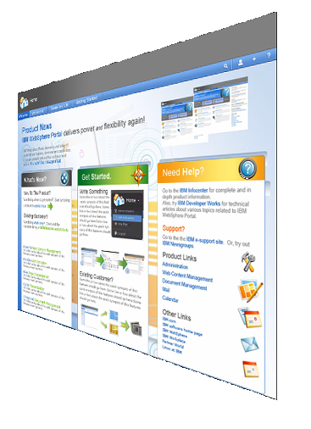
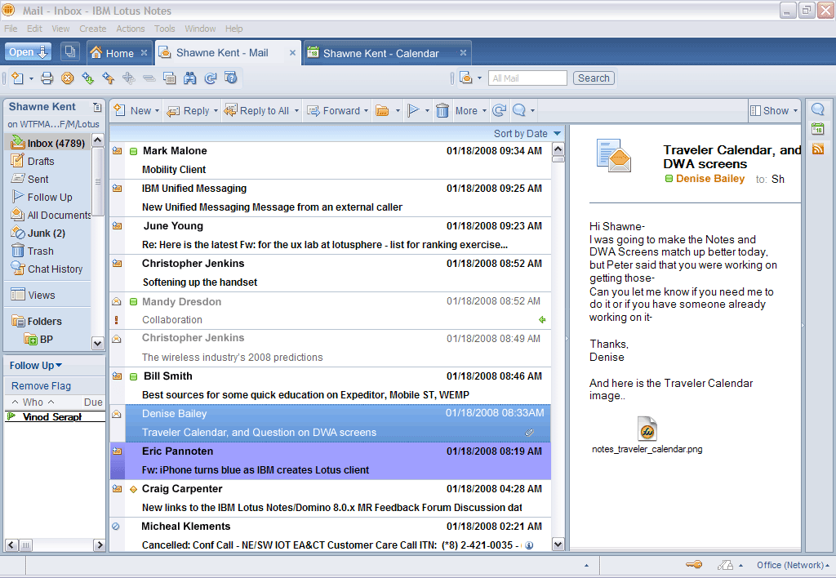



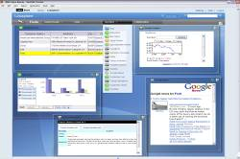














Integration Architecture
Collaborate in context from a single, unified view
Social networking— wikis, blogs, mashups, activities
Unified Communication, Instant Messaging
Personal and corporate content/document library
Documents, presentations, spreadsheets
Feeds, My Widgets, Live Text
IOC Platform
E-mail, calendar,
contacts
Collaborative and business applications
Leveraging current investments
20
Notes:
20
20
When someone asks what you do for work, you're unlikely to respond, " I send and receive emails for a living." Unfortunately, it sometimes feels like that. Your Inbox represents a valuable flow of information. While you're in it, you are more valuable. The problem is that sending and receiving emails doesn't amount to a unit of work, in most cases. We have to leave the valuable information flow in order to "get work done". When we do this, we are "out of the loop" for a period of time. Further, we run the risk of becoming distracted, prolonging our absence from the information flow. Notes keeps you "in the flow" by bringing the information to you. We do this by including IM/presence awareness, Lotus Quickr personal content library integration, the Lotus Symphony Editors, sidebar plug-ins, RSS feeds, composite applications and widgets invoked from Live Text.

Slide 21
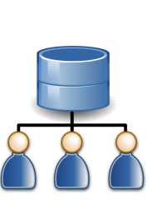






User Management
Integration Architecture
ARC Directory Services
ARC users have accounts in the ARC’s Directory Services systems (Active Directory).
ARC Users
ARC System Administrator
External Users
External users provide identifying information which is validated during sign-up.
Creates and manages ARC User Accounts
ARC Users
Are assigned to one or more
Pre-Defined Profiles
Which grant one or more
System Permissions

Slide 22
American Red Cross
22

Slide 23
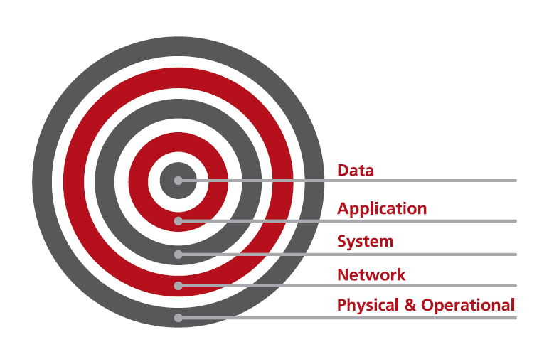
Approach to System Security
Security Architecture
The Solution employs a multi-level, Defense-in-Depth approach to protect systems against physical and electronic threats, taking into account:
Data Security
Application Security
System Security
Network Security
Physical and Operational Security
Layer upon layer of defenses—both hardware- and software-based— work together to help protect against, avoid, repel, and withstand any threat.

Slide 24
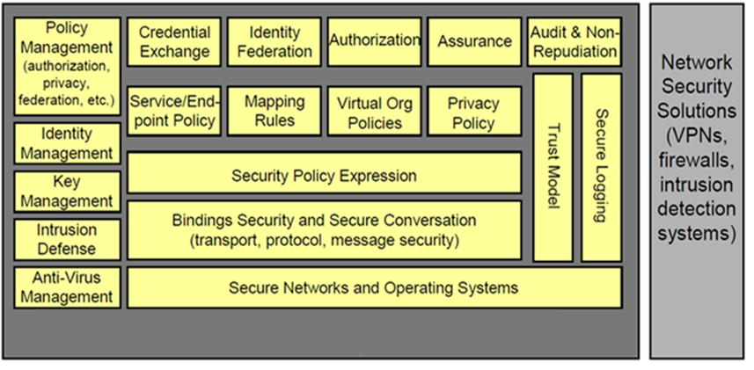
Logical Security Architecture
Security Architecture

Slide 25
Application
Security Architecture
Security is important within the IBM® Intelligent Operations Center because the solution is central to essential operations. To ensure security, it is important that you manage users of the solution to give all users the correct level of access.
The solution is designed for security including authentication and authorization.
Our solution supports the Lightweight Directory Access Protocol (LDAP) standard and can integrate with ARC’s Active Directory infrastructure
The solution supports SAML 2.0, the American Red Cross standard for federated authentication
The solution will integrate with Courion Access Assurance Suite (ARC Standard)
Our solution will support the automated provisioning and profile synchronization within 24 hours
Our solution will support the automated de-provisioning and role/Permission updates within 4 hours from the time the request is received
The solution supports a single sign-on architecture. It can be configured to accept tokens from other single sign-on providers using standards like SAML 2.0

Slide 26
Data
Security Architecture
Data Access
Solution controls access to data based on roles.
The solution includes the industry leading DB2 relational database that supports: Authentication, Authorization, Trusted Contexts, Auditing, Row & Column Access Control, Label-Based Access Control & Encryption controls
Data Integrity
The proposed solution includes mature and proven technologies that support data security and data integrity.
Data Monitoring
All system activities are monitored. Any unexpected requests are noted and shared with ARC’s security team.
Data Security
Our solution will provide data security and protection for data in-flight, as well as data at rest.
Best Practices
Our solution will avoid hardcoding user credentials into scripts; User credentials will be configuration and parameter based.

Slide 27
Security Architecture
Network Security
SoftLayer includes a rich set of functions, add-ons and configurable options
Content Delivery Network
24 nodes (integration with Object Storage)
Secure content management
Load balancing
Local (Array Networks)
Global (F5 – Discontinued)
Citrix Netscaler (Standard for Local and Platinum for Global)
Firewalls
Shared
Dedicated
Fortigate Security Appliance (alt Vyatta)
Application acceleration (Bare Metal, Netscaler, etc)
DNS services
IDS protection and assessment
McAfee Host Intrusion Protection with Reporting
SSL certificate management
Antivirus & malware protection (McAfee VirusScan)
27
27
Notes:
Unparalleled Flexibility and Power
Any physical server in any datacenter can be turned into any service
No silos of assets or services across the service platform
All services are available in all datacenters – true ubiquitous platform
27

Slide 28
Security Architecture
Data Center Security
Physical and operational security is the foundation of SoftLayer security - no other measures matter without it. That’s why every SoftLayer data center is fully audited based on SOC 2 Type II reporting on controls to meet industry-recognized requirements for security.
■ Data centers located only in facilities with controlled access and 24-hour security
■ No server room doors are public-facing
■ Server rooms are staffed 24/7
■ Un-marked entry and exit doors
■ Digital security video surveillance
■ Biometric & Key Card security systems for access to all data centers
■ Server room access strictly limited to SoftLayer employees and escorted contractors or visitors
■ Barcode-only identification on hardware; no customer markings of any type on the servers themselves
Data Center and Server Room Measures
■ Engineers and technicians trained on industry standard policies and procedures which are audited yearly
■ Geographic redundancy for all core systems for disaster recovery and business continuity
■ All data removed from re-provisioned machines with drive wipe software approved by the Department of Defense
■ Current SOC 2 Type II report
Operational Measures
28

Slide 29
Key Assumptions
Key Assumptions
The H3 system integrates with a variety of internal and external ARC systems. This integration will be done through well defined system interfaces defined during the planning phase of the project. The system owner of these systems will be responsible for any changes needed to these systems as a result of this project.
H3 will just capture the data needed for these system and pass that data through the interface mentioned above. H3 will not be the system of record for this data.
The system is designed to support 5000 concurrent users and 500 concurrent events.
American Red Cross is responsible for the development of ontologies and taxonomies.
ARC and Partner Vehicles are fitted with AVL device that sends real-time location information back to H3 over the mobile network.
ARC will provide access to the Subject Matter Experts as necessary for the duration of the project.
We will leverage the existing ESRI ArcGIS system.

Slide 30
American Red Cross
30

Slide 31
Agile Delivery Model
Development Methodology

Slide 32
Agile Delivery Model
Development Methodology

Slide 33
Development Methodology BUILD
Development Methodology
DEPLOY AND SUPPORT Deliver System documentation
Provide training to end users
Provide installation support
CONSTRUCTION AND TEST
Code and unit testing
Conduct System and Integration Testing
Conduct User acceptance testing
MODELLING
Create detailed design
Prepare detailed project plan
DEFINE
Conduct Requirement Analysis
Design Application Architecture
Prepare initial project plan
PLAN Define Scope
Estimate Effort
Decide Engagement Model

Slide 34
Implementation Strategy
Development Methodology
Iteration
Best Practices
Daily Build
Accepted
Build
Project
Check In
Effective Communication | “One team” approach | Commitment for all teams
Collaborative partnership | Frequent and Immediate feedback | Qualified and available resources | Governance |
Phased approach to delivery

Slide 35
Implementation Plan
Development Methodology

Slide 36
Development Methodology
Quality Management Methodology
Deliver using new
defined baseline
Analyze impact of
reforms/merger
Matured demand
planning
1
2
3
4
5
Increasing automation
across portfolio
Productivity
improvements
Define Baseline
Self Sustaining QA CoE
Automation Maintenance
100% compliance Outcome Based Model
100% compliance Outcome Based Model
Outcome and SLA’s
Define
Increase efficiency and
reduce defects
Increase efficiency and
reduce defects
Process Standardization and Audit
Estimation Based on productivity data
Engagement Model
Estimation Based on productivity data
UST
Measure
Risk and Reward Model
Control
Risk and Reward Model
Root Cause and Sub-root
Cause analysis
ARC H3
Responsive to ARC’s needs
Process /Technology Optimization
Improve
Analyze
Automation testing coverage
Benefits
Application Life Cycle Improvement
Accountability to Deliver SLA’s
Open Doors to Innovation
Cost /Benefits
Leveraging Horizontals Service s
Increase efficiency and
reduce defects

Slide 37
SDLC Environments
Environments
Development
Test
Training/UAT
Production/DR
Requirements
Standards
Constraints
Development tools
Requirements
Unit tested code
Constraints
Validation tools
Requirements
Constraints
Independently validated code
Production ready code, configurations, and software package
Production release schedule
Input
Environment preparation
Data preparation
Software development
Unit testing
Peer review
Environment preparation
Data preparation
Integration testing
Functional testing
Regression testing
Performance testing
Environment preparation
Data preparation
Prepare for training
Conduct training
Refresh environment
Schedule UAT testing
Conduct UAT testing
Necessary backups created
New changes introduced into production
Services and databases are brought back online, if necessary
Smoke tests conducted
Activities
Unit tested code
Configurations
Software package
Unit test results
Fully tested and independently validated code
Configurations
Software package
Test results
User training completed
User acceptance received
Production ready code, configurations, and software package
New changes are fully functional in production
Notifications of service availability sent
Outcome

Slide 38
Performance Testing High Level Approach
Performance Test Approach
Test Planning
Example Test Case
Open the ARC H3 portal (3 seconds)
Navigate to Add Event (1 Second)
Enter the Event details
Ensure that at least one mandatory field is left out
Submit the Page.
Verify that the Validation page is displayed
Enter the missed out value
Click on Submit
Verify if a routing Email message is displayed.(3 seconds)
Generate the email verification link through script
Click on the link
Login to the account using the user id and password.
Verify that the user account validation complete message is displayed
Log out of the portal
Application walkthrough, Environment Infrastructure, volumetric workload, Build test plan
Build performance environment test suite (scripts and scenarios)
Load Test Data
Test Execution
Execute Performance Tests
Gather Statistics
Collate and validate the results
Generate Recommendations
Performance Tuning and Retesting
Implement recommendations and fine tune the system
Retest and certify for production move

Slide 39




Regression Testing Approach
Regression Testing
Scientific Test Selection Technique
Master
Repository
360° Traceability Test Cases
∑
Test cases
to be
executed
+
Value
Proposition
UST Automation
Accelerators
Application Under Test (AUT)
Business Assurance Tests
+
Test Cases &
Scenarios
History Based Tests
Challenges
Value Proposition
Regression Test Factory
Lack of test coverage and defects in production
Lack of technique to scientifically select test cases
Lack of adequate application and test documentation
Lack of ROI, scale and maintainability
Reopening of defects
Is application getting tested adequately?
Are we getting proper ROI?
<1% weighted defect leakage
15%-25% Cost Savings through targeted regression
20% efficiency gain in automation and regression using proprietary merge and purge process
Flexible Resource Pool
Tools and Accelerators
Process Governance and
Metrics

Slide 40
Traceability through Traceability Matrix
Requirements Traceability
What is it
Ensuring traceability of every project artifact to individual requirement will ensure that the project requirements are met. It’s particularly important in QA to ensure adequate test coverage
Value Proposition
Use UST proprietary tools to create traceability matrix between requirements and test cases
Challenges addressed
Test Coverage
Application Stability
R1
TC1
TC3
TC5
TC2
R2
TC6
TC7
TC8
D1
R3
TC10
D2
Rn
TCm
Traceability Matrix
Requirements
Test cases
Defects
Requirements | Test Cases | Defects
R1 | TC1, TC2, TC3, TC4
R2 | TC7, TC6
R3 | TC8, TC10 | D1
Rn | TCm | D2

Slide 41
Service Delivery Management
Service Delivery
UST Global’s IT Service Delivery process framework based on ITIL V3 is designed to deliver IT services to the customer in a structured, reliable, and cost effective way in order to maintain a long-term customer relationship
ITIL Discipline
ITIL Process
UST Global Solution
Service Support
Service Deck
Incident Management
Problem Management
Change Management
Release Management
Configuration Management
IT Governance
IT Infrastructure Management
Managed Service
Remote Infrastructure Management
Service Delivery
Service Level Management
Availability Management
Capacity Management
Financial Management
IT Service Continuity Management
Business Perspective
Service Level Management
Financial Management
Change Management
Release Management
Infrastructure Management
Infrastructure Management
Service Management Phases

Slide 42






Production Support – Work Flow – L1 to L2 to L3
Support
American Red Cross users
End User Points of Communication
Work flows seamlessly from the Help desk (L1) managed by American Red Cross to the Production and Application Support team (L2) managed by UST to the Technical Support team (L3) managed by IBM.
Help Desk – Level 1 (ARC)
Technical Support
Level 2 – Tier 2 (UST)
Technical Support –
L3 (IBM)
Call Intake
Investigation and Diagnosis
Resolution and Recovery
Incident Closure
Incident Ownership, Monitoring, Tracking and communication

Slide 43
American Red Cross
Covered in meeting with ARC on Jan 21st
43

Slide 44
Q&A

Slide 45
Thank You

